Slide 1



www.covenantuniversity.edu.ng
Raising a new Generation of Leaders
CSC 432
FILE PROCESSING
LECTURE SEVEN

Slide 2
File Processing and Applications

Slide 3
File Managers Introduction
Various implementations of file management routines are available. Utility software are either integrated with operating system or available as off-the-shelf software.
A file manager or file browser is a computer program that provides a user interface to work with file systems. The most common operations are: Create, open, edit, view, print, play, rename, move, copy, delete, attributes, properties, search/find, and permissions.

Slide 4
File Managers Introduction
Files are typically displayed in a hierarchy. Some file managers contain features inspired by web browsers, including forward and back navigational buttons.
Some file managers provide network connectivity such as File Transfer Protocol (FTP), Network File System (NFS), Server Message Protocol (SMB) or Web Distributed Authoring and Versioning (WebDAV).
This is achieved either by allowing the user to browse for a file server, connect to it and access the server's file system like a local file system, or by providing its own full client implementations for file server protocols.

Slide 5
File Managers Introduction (Cont)
File managers can be:
Orthodox
File list
Directory editors
Spatial file managers
3-D file managers
Navigational file managers
Web-based file managers.

Slide 6
Navigational File Manager
A navigational file manager, also called an Explorer type manager, is a newer type of file manager as commonly found in Microsoft Windows.
The Windows Explorer is a classic representation of the type, using a "navigational" metaphor to represent file system locations. An exploration of GUI.

Slide 7
Features of Navigational File Manager
The window displays the location currently being viewed.
The location being viewed (the current directory) can be changed by the user, by opening folders, pressing a back button, typing a location, or using additional pane with the navigation tree representing part or all the file system.
Icons represent files, programs, and directories.

Slide 8
Features of Navigational File Manager (Cont)
The File navigation operations include Back, Forward, Reload, Drag and Drop, Clipboard Operations. It is possible to view many directories at the same time and perform cut and paste operations between instances.
The usage of GUI is embraced here. Examples of Navigational File Manager are: Windows Explorer, Mac OS X Finder, Xtree/ZTreeWin, XYPlorer.

Slide 9
Web-Based File Manager
Web-based file managers are typically scripts written in PHP, Perl, Asp or any other server side languages. When installed on a local server or on a remotely hosted server they allow files and folders located there to be managed and edited without the need for FTP access.
More advanced, and usually commercially distributed, web-based file management scripts allow the administrator of the file manager to configure and secure individual user accounts, each with individual account permissions.

Slide 10
Web-Based File Manager (Cont)
Authorized users have access to documents stored on the server or in their individual user folders anytime from anywhere via a web browser.
A web-based file manager can serve as an organization's digital repository. For example, documents, digital media, publishing layouts, and presentations can be stored, managed, and shared between customers, suppliers, remote workers or just internally.

Slide 11
MANAGING FILES IN WINDOWS
There are basically three ways of managing files in Windows operating systems:
From within a Program
By using My Computer
By using Windows Explorer.

Slide 12
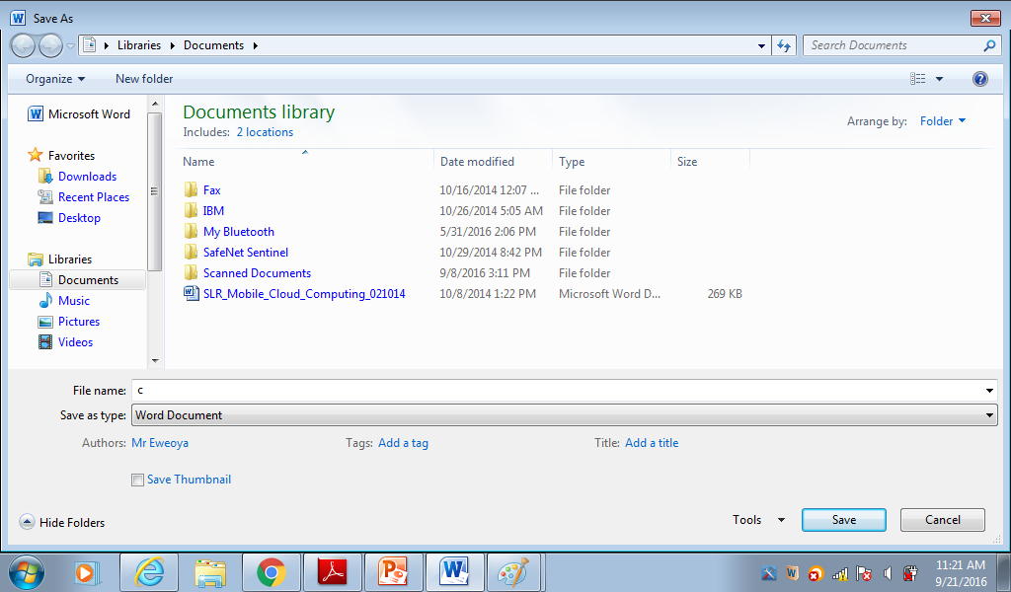
The Save As Dialog Box in Windows

Slide 13
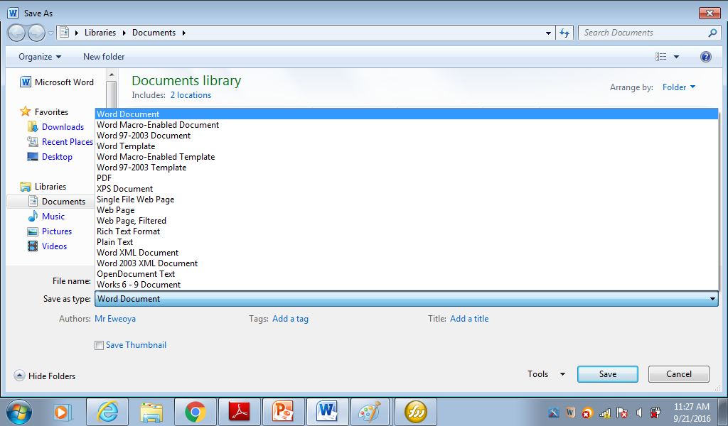
`Save As Type What?

Slide 14
Tips for Management of Electronic Files
Organize by file types
One place for all
Create folders in My Documents
Nest folders within folders
Follow the file naming conventions
Be specific
File as you go
Order your files for your convenience
Cull your files regularly
Back up your files regularly

Slide 15
FILE SORTING, SEARCHING, AND MERGING
Computer or electronic files are stored in main memory or secondary storage devices. Retrieval, re-arrangement or manipulation is done on these files for some purposes.

Slide 16
Sorting
A Sorting Algorithm is a prescribed set of well-defined rules or instructions that puts elements of a list in a certain order. The most-used orders are numerical order and lexicographical order.
Efficient sorting is important to optimizing the use of other algorithms (such as search and merge algorithms) that require sorted lists to work correctly.

Slide 17
Selection Sort
The idea behind selection sort is that we put a list in order by placing each item in turn. In other words, we put the smallest item at the start of the list, then the next smallest item at the second position in the list, and so on until the list is in order.
Algorithm for selection sort
for i=0 to N-2 {
set smallest = i
for j=i+1 to N-1 {
compare list[smallest] to list[j]
if list[smallest] == list[j]
smallest = j
}
swap list[i] and list[smallest]
}

Slide 18
Selection Sort
The worst case for selection sort occurs when the ﬁrst item in the list is the largest, and the rest of the list is in order.
In this case, we perform one swap on each pass through the algorithm, so the number of swaps is N. The number of comparisons is the same as in the best case, O(N2).
The average case requires the same number of comparisons, O(N2), and roughly N/2 swaps. Thus, the number of swaps in the average case is O(N).
In summary, we say that selection sort is O(N) in swaps and O(N2) in comparisons.

Slide 19
Bubble Sort
It continuously steps through a list, swapping items until they appear in the correct order.
The algorithm starts at the beginning of the data set. It compares the first two elements, and if the first is greater than the second, it swaps them.
It continues doing this for each pair of adjacent elements to the end of the data set. It then starts again with the first two elements, repeating until no swaps have occurred on the last pass. While simple, this algorithm is highly inefficient and is rarely used.

Slide 20
Bubble Sort
Algorithm for bubble sort
for i=N-1 to 2 {
set swap flag to false
for j=1 to i {
if list[j-1] > list[j]
swap list[j-1] and list[j]
set swap flag to true
}
if swap flag is false, break. The list is sorted.
}

Slide 21
Bubble Sort
The best case for bubble sort occurs when the list is already sorted. In this case, the number of swaps is zero. We still have to compare each item in the list to each other item in the list on each pass through the algorithm.
The ﬁrst time through, we compare the ﬁrst item in the list to all other items in the list, so the number of comparisons is (N-1). The second time through, we compare the second item in the list to the remaining items in the list, so the number of comparisons is (N-2).
It turns out that the total number of comparisons for bubble sort in the average and worst case is (N −1) + (N −2) + ... + 2 + 1. This equation simpliﬁes to N(N +1)/2−1, which is approximately N2. Thus, even in the best case, selection sort requires O(N2) comparisons.

Slide 22
Insertion Sort
This is a simple sorting algorithm that is relatively efficient for small lists and mostly-sorted lists, and often used as part of more sophisticated algorithms.
It works by taking elements from the list one by one and inserting them in their correct position into a new sorted list.
In arrays, the new list and the remaining elements can share the array's space, but insertion is expensive, requiring shifting all following elements over by one. Shell sort is a variant of insertion sort that is more efficient.

Slide 23
Shell Sort
An improvement upon bubble sort and insertion sort by moving out of order elements more than one position at a time.
One implementation can be described as arranging the data sequence in a two-dimensional array and then sorting the columns of the array using insertion sort.
Although this method is inefficient for large data sets, it is one of the fastest algorithms for sorting small numbers of elements.

Slide 24
Merge Sort
Merge sort takes advantage of the ease of merging already sorted lists into a new sorted list. It starts by comparing every two elements (i.e., 1 with 2, then 3 with 4...) and swapping them if the first should come after the second.
It then merges each of the resulting lists of two into lists of four, then merges those lists of four, and so on; until at last two lists are merged into the final sorted list.
Of the algorithms described here, this is the first that scales well to very large list.

Slide 25
Heap Sort
Heap sort is a more efficient version of selection sort. It also works by determining the largest (or smallest) element of the list, placing that at the end (or beginning) of the list, then continuing with the rest of the list, but accomplishes this task efficiently by using a data structure called a heap, a special type of binary tree.
Once the data list has been made into a heap, the root node is guaranteed to be the largest (or smallest) element. When it is removed and placed at the end of the list, the heap is re-arranged so the largest element remaining moves to the root.

Slide 26
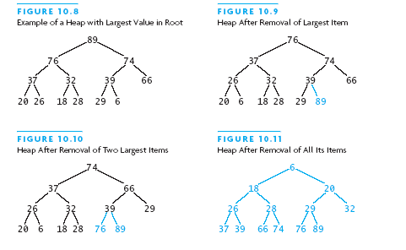
Heapsort Picture
Heap Sort (Cont)

Slide 27
Quick Sort
Quick sort is a divide and conquer algorithm which relies on a partition operation: to partition an array, we choose an element, called a pivot, move all smaller elements before the pivot, and move all greater elements after it. This can be done efficiently in linear time and in-place.
We then, recursively sort the lesser and greater sub-lists. Efficient implementations of quick sort (with in-place partitioning) are typically unstable sorts and somewhat complex, but are among the fastest sorting algorithms in practice.

Slide 28
Quick Sort (Cont)
Because of its modest space usage, quick sort is one of the most popular sorting algorithms, available in many standard libraries.
The most complex issue in quick sort is choosing a good pivot element; consistently poor choices of pivots can result in drastically slower performance, but if at each step we choose the median as the pivot then it works with better performance.

Slide 29
Quick Sort (Cont)
Let’s sort the list {15, 4, 23, 12, 56, 2} by quicksort. The ﬁrst thing we need to do is select a pivot. We can select any item of the list as our pivot, so for convenience let’s select the ﬁrst item, 15.
Now, let’s ﬁnd the ﬁrst item in the list that’s greater than our pivot. We’ll use the variable low to store the index of this item. Starting with the ﬁrst item beyond the pivot (4), we ﬁnd that the ﬁrst item that is greater than 15 is 23. So we set low = 2, since 23 is at index 2 in the list. Next, we start at the end of the list and work back toward the beginning of the list, looking for the ﬁrst item that is less than the pivot.
We’ll use the variable high to store the index of this item. The last item in the list, 2, is less than our pivot (15), so we set high = 5, since 2 is at index 5 in the list. Now that we’ve found two items that are out of place in the list, we swap them. So, now our list looks like this: {15, 4, 2, 12, 56, 23}. We also increment low and decrement high by 1 before continuing our search. Now, low = 3 and high = 4, and these correspond to 2 and 56, respectively, in the list.

Slide 30
Bucket Sort
Bucket sort is a sorting algorithm that works by partitioning an array into a finite number of buckets. Each bucket is then sorted individually, either using a different sorting algorithm, or by recursively applying the bucket sorting algorithm.
Thus this is most effective on data whose values are limited. A variation of this method called the single buffered count sort is faster than quick sort and takes about the same time to run on any set of data.

Slide 31
Radix Sort
Radix sort is an algorithm that sorts a list of fixed-size numbers of length k by treating them as bit strings. We first sort the list by the least significant bit while preserving their relative order using a stable sort.
Then we sort them by the next bit, and so on from right to left, and the list will end up sorted. Most often, the counting sort algorithm is used to accomplish the bitwise sorting, since the number of values a bit can have is minimal - only ‘1’ or ‘0’.

Slide 32
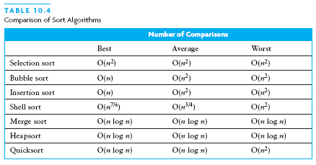
Comparison of Sort Algorithms

Slide 33
Searching Techniques
A search algorithm is simply an algorithm that takes a problem as input and returns a solution to the problem, usually after evaluating a number of possible solutions.
The set of all possible solutions to a problem is called the search space.

Slide 34
Uninformed Vs Informed Search
Uninformed Algorithms use Brute-force search, also called a naïve search, it uses the simplest method of searching through the search space one by one for the expected result.
Informed Search Algorithms use heuristic functions to apply knowledge about the structure of the search space to try to reduce the amount of time spent searching.

Slide 35
Uninformed Search
Uninformed Search - Not specific to the nature of a problem, can be implemented in general, and then the same implementation can be used in a wide range of problems due to abstraction.
The drawback is that, in actual practice, many search spaces are extremely large, and an uninformed search (especially of tree or graph storage structures) will take a reasonable amount of time for even relatively small examples.

Slide 36
Linear Search
The simplest of such an algorithm is linear search, which examines each element of the list as they are encountered.
It is expensive in running time compared to many other algorithms.
It can be used directly on any unprocessed list, regardless of history, which is sometimes useful. search.

Slide 37
Linear Search
Algorithm for linear search
for (each item in list) {
compare search term to current item
if match,
save index of matching item break
}
return index of matching item, or -1 if item not found

Slide 38
Linear Search
Performance of linear search: When comparing search algorithms, we only look at the number of comparisons, since we don’t swap any values while searching. Often, when comparing performance, we look at three cases:
• Best case: What is the fewest number of comparisons necessary to ﬁnd an item?
• Worst case: What is the most number of comparisons necessary to ﬁnd an item?
• Average case: On average, how many comparisons does it take to ﬁnd an item in the list? For linear search, our cases look like this:
• Best case: The best case occurs when the search term is in the ﬁrst slot in the array. The number of comparisons in this case is 1.
• Worst case: The worst case occurs when the search term is in the last slot in the array, or is not in the array. The number of comparisons in this case is equal to the size of the array. If our array has N items, then it takes N comparisons in the worst case.
• Average case: On average, the search term will be somewhere in the middle of the array. The number of comparisons in this case is approximately N/2. In both the worst case and the average case, the number of comparisons is proportional to the number of items in the array, N. Thus, we say in these two cases that the number of comparisons is order N, or O(N) for short. For the best case, we say the number of comparisons is order 1, or O(1) for short.

Slide 39
Binary Search
This is significantly better than linear search for large lists, but is sometimes useful for surprisingly small ones given its increase in speed.
Also, it requires the list be sorted before searching and generally that the list be randomly accessible.
This may force lengthy reads of mass storage before a binary search can be started.
In general, the worst case for binary search is order log N, or O(logN). The average case occurs when the search term is anywhere else in the list. The number of comparisons is roughly the same as for the worst case, so it also is O(logN).
In general, anytime an algorithm involves dividing a list in half, the number of operations is O(log N).

Slide 40
Binary Search
The idea behind binary search is that each time we make a comparison, we eliminate half of the list, until we either ﬁnd the search term or determine that the term is not in the list.
We do this by looking at the middle item in the list, and determining if our search term is higher or lower than the middle item. If it’s lower, we eliminate the upper half of the list and repeat our search starting at the point halfway between the ﬁrst item and the middle item.
If it’s higher, we eliminate the lower half of the list and repeat our search starting at the point halfway between the middle item and the last item

Slide 41
Binary Search
Algorithm for binary search
set first = 1, last = N, mid = N/2
while (item not found and first < last) {
compare search term to item at mid
if match save index break
else if search term is less than item at mid,
set last = mid-1
else
set first = mid+1 set mid = (first+last)/2
}
return index of matching item, or -1 if not found

Slide 42
Hash Tables
Hash tables can also be used for list searches. They run in constant time in the average case, but have terrible worst-case time. In addition, more space and time is required to set up such tables.
Another search based on specialized data structures uses self-balancing binary search trees. Such tree searches can be seen as extending the ideas of binary search to allow fast insertion and removal in the data structures.

Slide 43
Tree Search
Tree search algorithms are likely the most used searching techniques for structured data. They examine nodes of trees.
The basic principle is that a node is taken from a data structure, its successors examined and added to the data structure. By manipulating the data structure, the tree can be explored in different orders.

Slide 44
Tree Search (Cont)
For instance, level by level (i.e., breadth-first search) or reaching a leaf node first and backtracking (i.e., depth-first search), etc.
Other examples of tree-searches include:
Iterative-deepening search
Depth-limited search,
Bidirectional search, and
Uniform-cost search.

Slide 45
Graph Search
Many of the problems in graph theory can be solved using graph traversal algorithms, such as
Dijkstra’s algorithm
Kruskal’s algorithm
The nearest neighbour algorithm
Prim's algorithm
These can be seen as extensions of the tree-search algorithms.

Slide 46
Informed Search Adversarial Search
In an informed search, a heuristic that is specific to the problem is used as a guide. A good heuristic will make an informed search dramatically out-perform any uninformed search.
Game-playing computer programs, as well as other forms of artificial intelligence often use search algorithms like the mini-max algorithm, search tree pruning, and alpha-beta pruning.

Slide 47
Constraint Satisfaction
This is a type of search which solves constraint satisfaction problems rather than looking for a data value. The solution sought is a set of values assigned to a set of variables.
Because the variables can be processed in any order, the usual tree search algorithms are not suitable.

Slide 48
Constraint Satisfaction (Cont)
Methods of solving constraint problems include combinatorial search and backtracking, both of which take advantage of the freedom associated with constraint problems.
Common tricks or techniques involved in backtracking are 'constraint propagation’, which is a general form of ‘forward checking'. Other local search algorithms, such as generic algorithm, which minimize the conflicts may also be practical.

Slide 49
Merge Algorithms
Merge algorithms are a family of algorithms that run sequentially over multiple sorted lists, typically producing more sorted lists as output.
This is well-suited for machines with tape drives. Its usage has declined due to large random access memories, and many applications of merge algorithms have faster alternatives when a random-access memory is available.

Slide 50
Merging Language Support
The C++’s Standard Template Library has the function std::merge, which merges two sorted ranges of iterators, and std::inplace merge, which merges two consecutive sorted ranges in-place.
In addition, the std::list (linked list) class has its own merge method which merges another list into itself. The type of the elements merged must support the less-than (<) operator, or it must be provided with a custom comparator.
PHP has the array merge() and array_merge_recursive() functions.

Slide 51
File Handling in High Level Languages
Programming languages have facilities embedded in them to read data values from a file stored in the computer memory or any storage device.
The syntax differs from one programming language to another.
The operating system has efficient ways of managing various files generated by any programming language

Slide 52
C Language File Input/Output
The C programming language provides many standard library functions for file input and output. These functions make up the bulk of the C standard library header <stdio.h>.
The I/O functionality of C is fairly low-level by modern standards; C abstracts all file operations into operations on streams of bytes, which may be “input streams” or “output streams”.

Slide 53
C Language File Input/Output (Cont)
The stream model of file I/O was popularized by the Unix operating system, which was developed concurrently with the C programming language itself.
A large number of modern operating systems have inherited streams from Unix, and many languages in the C programming language family have inherited C's file I/O interface with few if any changes (for example, PHP). The C++ standard library reflects the “stream” concept in its syntax.

Slide 54
Opening a File Using Fopen
A file is opened using fopen, which returns an I/O stream attached to the specified file or other device from which reading and writing can be done. If the function fails, it returns a null pointer.
The related C library function freopen performs the same operation after first closing any open stream associated with its parameters.

Slide 55
Opening a File Using Fopen (Cont)
FILE *fopen(const char *path, const char *mode);
FILE *freopen(const char *path, const char *mode, FILE *fp);

Slide 56
Closing a Stream Using fclose
The fclose function takes one argument: a pointer to the FILE structure of the stream to close. int fclose(FILE *fp);
The function returns zero on success, or EOF on failure. The program on the next slide opens a file named sample.txt, writes a string of characters to the file, then closes it.

Slide 57
Opening, writing, and closing a file The file is named sample.txt
#include <stdio.h>
#include <string.h>
#include <stdlib.h>
int main(void)
{
FILE *fp;
size_t count;
const char *str = "hello\n";
fp = fopen("sample.txt", "w");
if(fp == NULL) {

Slide 58
Opening, writing, and closing a file The file is named sample.txt
perror("failed to open sample.txt");
return EXIT_FAILURE;
}
count = fwrite(str, 1, strlen(str), fp);
printf("Wrote %zu bytes. fclose(fp) %s.\n",
count, fclose(fp) == 0 ? "succeeded" :
"failed");
fclose(fp);//close de file
return EXIT_SUCCESS;
}

Slide 59
Homework
Write a C program that opens a binary file called myfile, reads five bytes from it, and then closes the file.

Slide 60
Text File Operations in C#
C-Sharp provides a File class which is used in manipulating text files.
The File class is within the System namespace. Also we can use the StreamReader and StreamWriter classes, which are within the System.IO, namespace for reading from and writing to a text file.
Now, we see examples of creating a text file, reading contents of a text file and appending lines to a text file.

Slide 61
Creating a Text File
For creating text file we use the CreateText Method of the File Class.
The CreateText Method takes in the path of the file to be created as an argument. It creates a file in the specified path and returns a StreamWriter object which can be used to write contents to the file.

Slide 62
Creation of a Text File in C#
public class FileClass
{
public static void Main()
{
WriteToFile();
}
static void WriteToFile()
{
StreamWriter SW;
SW=File.CreateText("c:\\MyTextFile.txt");
SW.WriteLine("God is greatest of them all");
SW.WriteLine("This is second line");
SW.Close();
Console.WriteLine(“File Created
SuccessFully”);
}
}

Slide 63
Reading Contents of a Text File
For reading the contents of a text file we use the OpenText Method of the File class. The OpenText Method takes in the path of the file to be opened as an argument.
It opens the specified file and returns a StreamReader object which can be used to read the contents of the file. For example:

Slide 64
Reading Contents of a Text File using C#
public class FileClass
{
public static void Main()
{
ReadFromFile("c:\\MyTextFile.txt");
}
static void ReadFromFile(string filename)
{
StreamReader SR;
string S;
SR=File.OpenText(filename);
S=SR.ReadLine();
while(S!=null)
{
Console.WriteLine(S);
S=SR.ReadLine();
}
SR.Close();
}
}

Slide 65
Appending Content to a Text File
For appending content to a text file we use the AppendText Method of the File class. The AppendText method takes in the path of the file to which the contents to be appended as an argument.
It opens the file in the specified path and returns a StreamWriter object which can be used to append contents to the file.

Slide 66
Appending Content to a Text File with C#
public class FileClass
{
public static void Main()
{
AppendToFile();
}
static void AppendToFile()
{
StreamWriter SW;
SW=File.AppendText("C:\\MyTextFile.txt");
SW.WriteLine("This Line Is Appended");
SW.Close();
Console.WriteLine("Text Appended
Successfully");
}
}

Slide 67
References
Davis, W. S. & Rajkumar, T.M. (2001). Operating Systems: A Systematic View (5th Edition). New Jersey: Addison-Wesley.
Deitel, H. M. (2004). Operating Systems, (3rd Edition). New Jersey: Prentice Hall.
Encarta (2007) http://en.www.wikipedia.com.
Stallings, Williams (2004). Operating Systems; Internal and Design Principles, (5th Edition). New Jersey: Prentice Hall.
Tanenbaum, A. S. (2006). Modern Operating System, (3rd Edition). New Jersey: Prentice Hall.
Williams, B. K. (1999). Using Information Technology: A Practical Information to Computers and Communications. (3rd Edition). Boston: McGraw Hill.
Ismaila O. Mudasiru, (2011), File Processing and Management, Course Guide, NOUN.

